Slide 1
So You Think You Can Sing?
ECE532
Group 13
04/01/2025
Srinidhi Shankar, Jennifer Mah, Jimmy Velasco, Natasha Yang

Slide 2
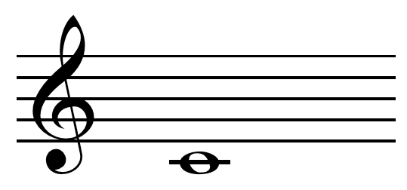
Sight Reading and Pitch Detection
HDMI: displays notes on the screen in musical notation
Push button: used to play notes on speaker, show actual note on OLED, and go to the next note
Microphone: user will emulate those notes into the microphone (by either sight reading or listening to it first)
Pitch detection algorithm: will use FFT and general logic to display the desired and actual note
OLEDs: displays the desired and actual note
Notes:
srini

Slide 3
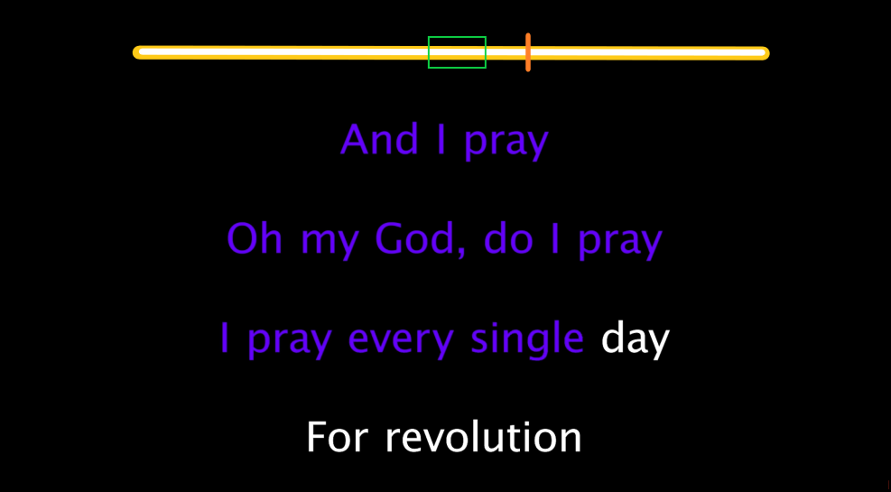
Original Idea: Karaoke Machine
Karaoke: lyrics on screen, audio backtrack and a microphone to sing into.
Tone Matching: the user can see how well they are matching pitch throughout the entire song.
Scoring System: scoring the user’s performance against the original audio.
3
Notes:
srini

Slide 4
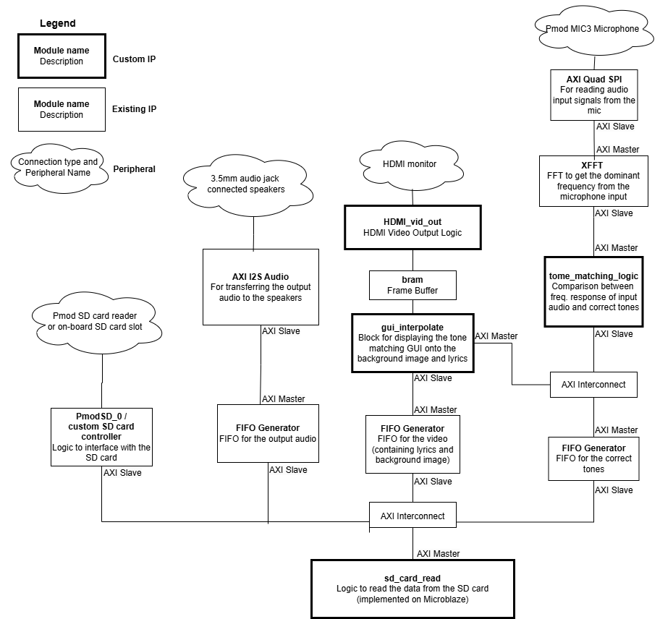
Original System Diagram
Notes:
jen

Slide 5
Current Main Components
Peripherals
PMOD MEMS Microphone: receives sound input
Speaker: plays the desired note
OLEDs: displays the desired note and note sung on the OLEDs
HDMI: displays the desired note in musical notation
Buttons: used to go to the next note
IPs
ADC Controller/Decimator: controls and down-samples the microphone input
FFT IP: takes the ADC controller/decimator output and passes it through an FFT
Tone Matching IP: gets the dominant frequency from the FFT and matches it to a note
OLED IP: display the note from the tone matching IP
HDMI IP: controls HDMI
Notes:
natasha

Slide 6
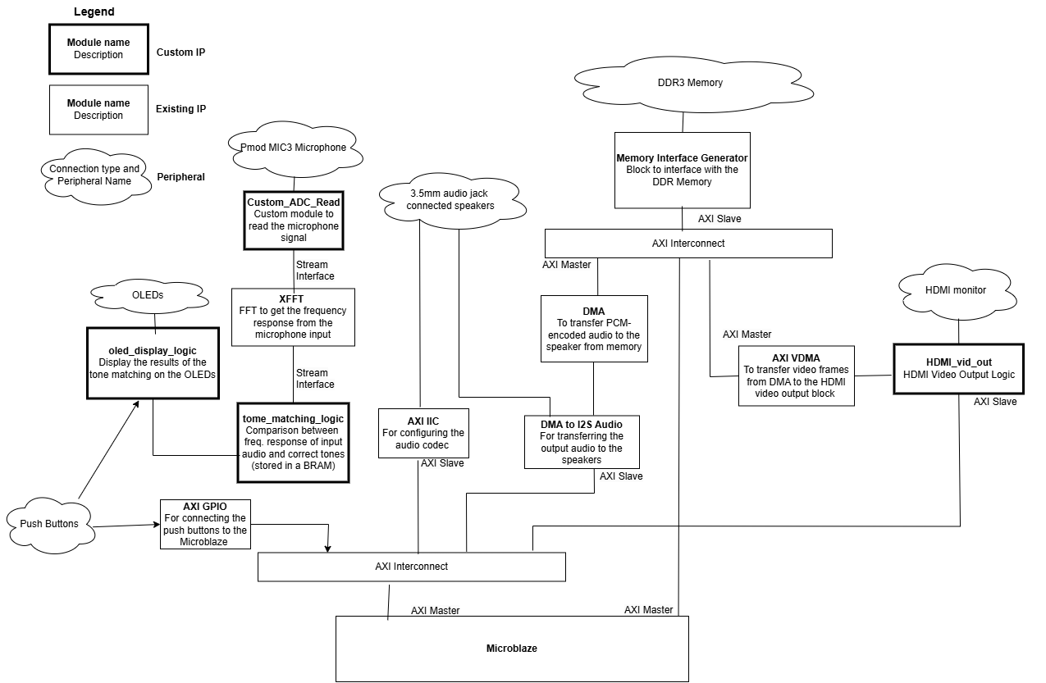
Current System Diagram
Notes:
jen

Slide 7
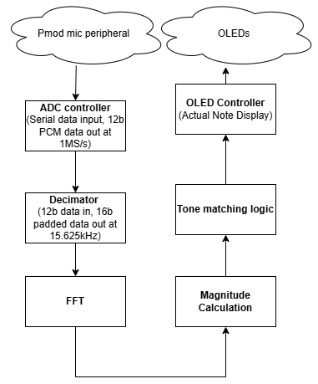
Bus and Data Storage

Slide 8
ADC Controller/Decimator Edited Third Party IP
PMOD SPI interface – with high chip select, get 12 bit sample value and set the ready bit to high. 16 samples with 4 leading zeroes.
Decimator takes the 12 bit input from the ADC and everytime the ADC outputs data, the register count increments. When count = 64, decimator outputs data to FFT, and sets the enable for the FFT.
Notes:
srini

Slide 9
Tone Detection
Finds the dominant frequency, block diagram inspired by this example design:
Logic to store all the samples in a BRAM for buffering and then send to FFT was inspired by this example
1. From decimator, sends samples to a BRAM for buffering
2. From BRAM, send to FFT for processing
3. FFT sends output to logic to calculate magnitude of sample
Notes:
natasha

Slide 10
Tone Matching Custom IP
Finds the sample with the max magnitude of the FFT output
Each sample corresponds to a range of frequencies, which is mapped to a note
Sample with max magnitude is mapped to a note name (ASCII)
Note name gets outputted to the OLED control block
Notes:
natasha

Slide 11
OLED Edited Third Party IP
Displays the name of the note that should be sung, and the name of the note that was actually sung.
Adapted from Diligent demo. Changes include:
The text shown on OLEDs
Display text on button release, not press
Text stored as localparams and passed into memory to be read by OLED interface logic when button pressed (what gets written is dependant by state)
Notes:
jimmy

Slide 12
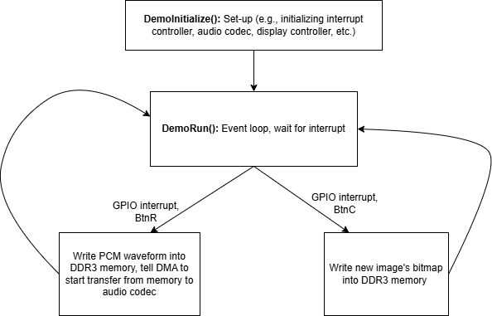
Software Details (HDMI and Speaker)
Notes:
jen

Slide 13
HDMI Edited Third Party Block Diagram and Software
Shows the note to be sung on the monitor.
Adapted from Diligent demo:
Removed HDMI input signal, instead use Dynamic Clock Generator block for timing
Software was changed to no longer support pass-through, and instead show a bitmap image saved in Microblaze stack memory
Software sends a bitmap image to DDR3, Video DMA sends it to HDMI display logic
Notes:
jen/jimmy

Slide 14
Speaker Third Party Block Diagram and Software
Plays the notes that should be sung as a reference for the user.
Adapted from Diligent demo:
Only thing kept was the block diagram, set-up code, and audio codec interfacing functions
Software writes a PCM waveform corresponding to a note into DDR3 memory, tells DMA to start transferring to HPH out
Notes:
jimmy/jen

Slide 15
Difficulty Score
Description | Score
HDMI output on Nexys-Video | 1.0
OLED implementation on Nexys-Video | 0.75
PMOD Microphone Peripheral | 0.75
On-board audio output port | 0.50
Visualize meaningful results with a GUI | 0.75
Print on Terminal Something More Meaningful | 0.25
IP Core implemented in FPGA Hardware | 0.5 - 1.5
TOTAL | 4.0 - 5.0
Notes:
natasha

Slide 16
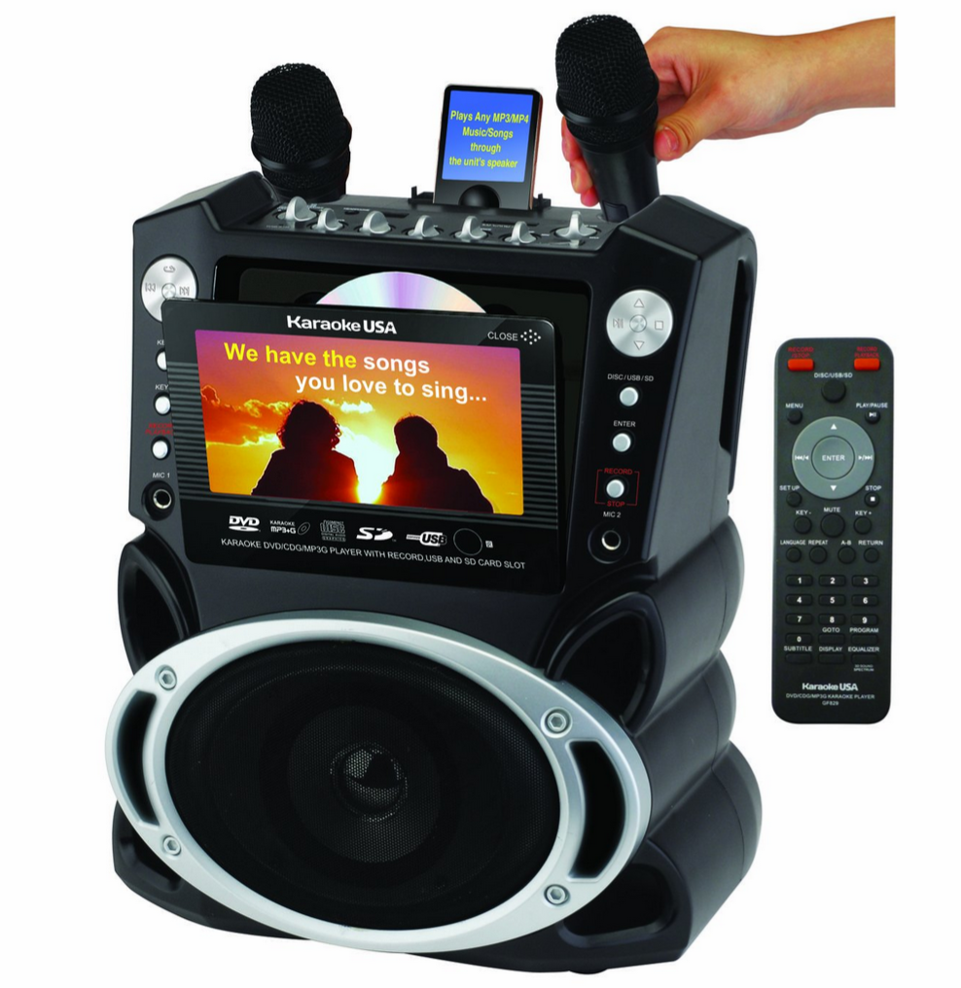
Improvements
Filtering: implement more filtering so input can be better detected
Better tone matching: it can detect notes from C4-B4
Add a song: have tone matching implemented on a song
Add to HDMI: add words and animations
Add scoring algorithm: give a score based on note accuracy at the end of the song
Add microphone input to speaker output: ability to hear yourself through the speaker
Notes:
natasha

Slide 17
Demo Time!

